Slide 1
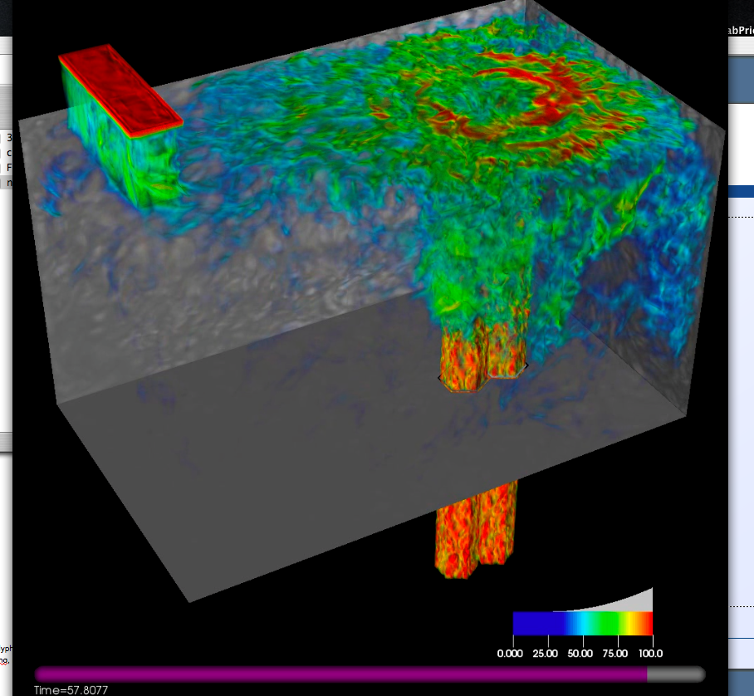
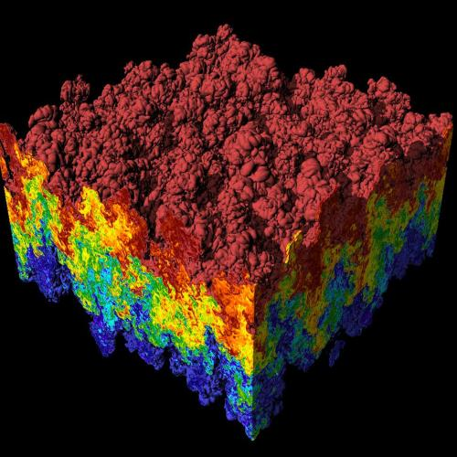
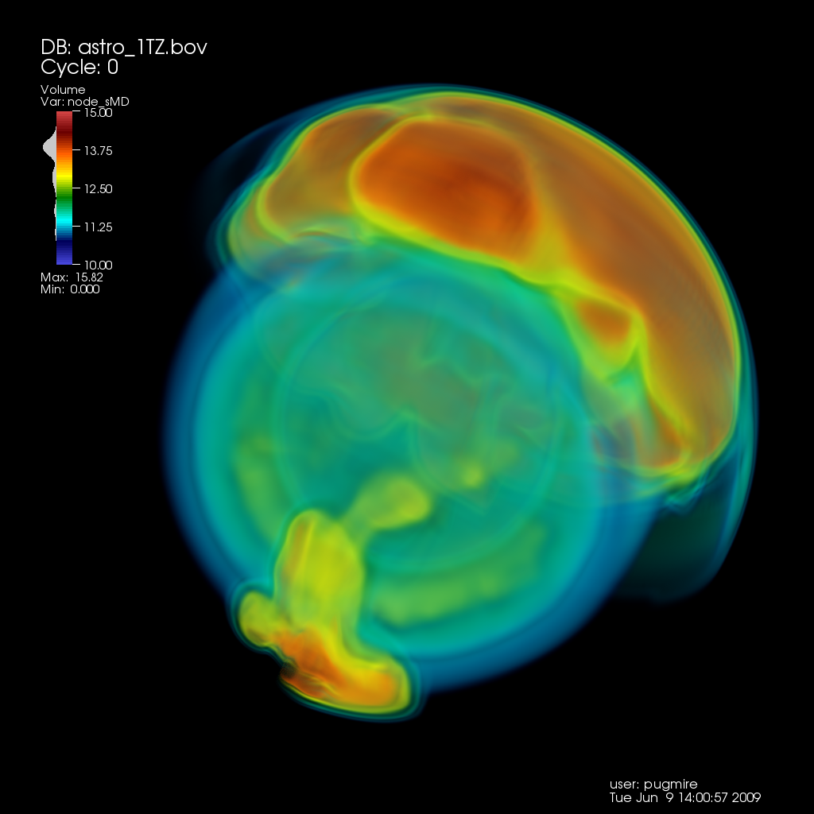
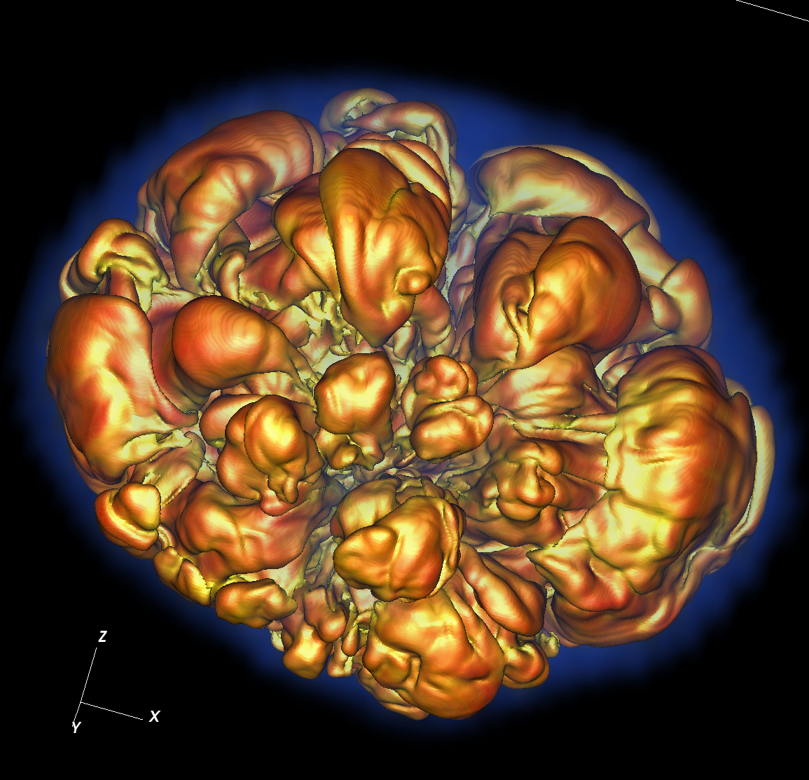
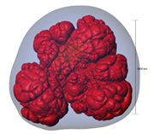
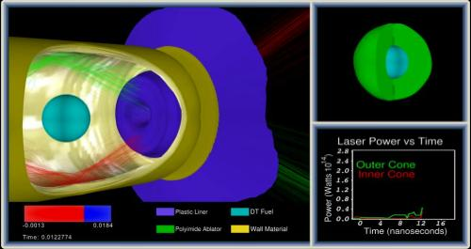
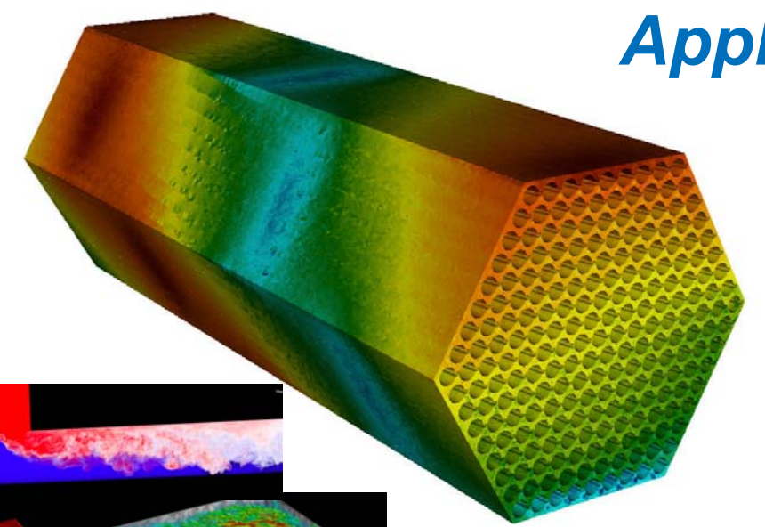
CIS 441/541: Intro to Computer Graphics Lecture 4: Interpolation
January 22, 2019
Hank Childs, University of Oregon

Slide 2
Taylor…

Slide 3
No Class Tuesday, 1/29
Will definitely be a YouTube lecture to replace that one.

Slide 4
Office Hours: Weeks 3-10
Monday: 1-2 (Roscoe)
Tuesday: 1-2 (Roscoe)
Wednesday: 1-3 (Roscoe)
Thursday: 1130-1230 (Hank)
Friday: 1130-1230 (Hank)
BUT: have a previously scheduled obligation this week
So: Thurs 1230-130 or Fri 9am-10am?

Slide 5
Timeline
1C: due Weds Jan 23rd
1D: assigned today, due Thurs Jan 31st
1E: assigned Thurs Jan 31st, due Weds Feb 6th
→ will be extra support with this. Tough project.
1F: assigned Feb 7th, due Feb 19th
→ not as tough as 1E
2A: will be assigned during week of Feb 11th
Sun | Mon | Tues | Weds | Thurs | Fri | Sat
Jan 20 | Jan21 | Jan 22 Lec4 | Jan 23 1C due | Lec 5 1D assigned | Jan 25 | Jan 26
Jan 27 | Jan 28 | Jan 29 (YouTube) | Jan 30 | Lec 6 1D due 1E assigned | Feb 1 | Feb 2
Feb 3 | Feb 4 | Feb 5 | Feb 6 | Feb 7 1E due 1F assigned | Feb 8 | Feb 9
Likely: pre-SuperBowl OH

Slide 6
Arbitrary Triangles
The description of the scanline algorithm in the preceding slides is general.
But the implementation for these three triangles vary:

Slide 7
Arbitrary Triangles
Project #1B: implement the scanline algorithm for “going down” triangles
Project #1C: arbitrary triangles

Slide 8
Arbitrary Triangles
Function: RasterizeGoingDownTriangle
(You have this from 1B)
Function: RasterizeGoingUpTriangle
(You can write this by modifying RasterizeGoingDownTriangle)
Function: RasterizeArbitraryTriangle
Split into two triangles
Call RasterizeGoingUpTriangle and RasterizeGoingDownTriangle

Slide 9

Project #1C (6%), Due (Jan 23rd)
Goal: apply the scanline algorithm to arbitrary triangles and output an image.
Extend your project1B code
File proj1c_geometry.vtk available on web (80MB)
File “reader.cxx” has code to read triangles from file.
No Cmake, project1c.cxx

Slide 10
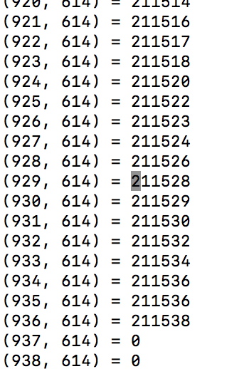
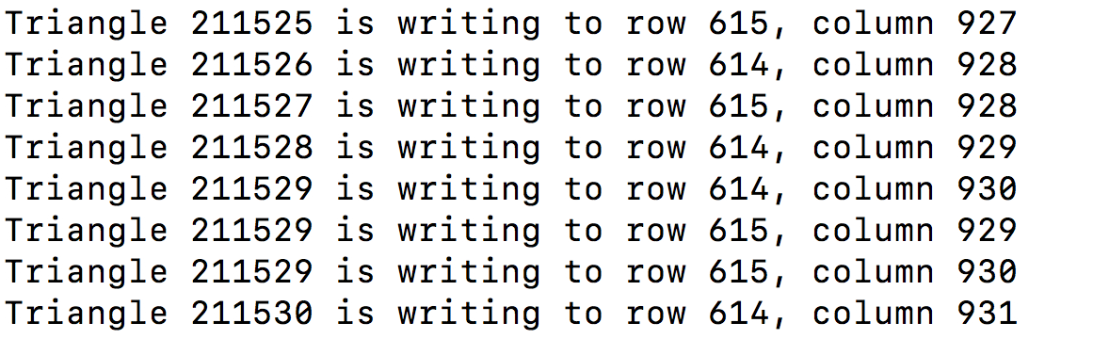
File triangle_ids
Output from my program

Slide 11
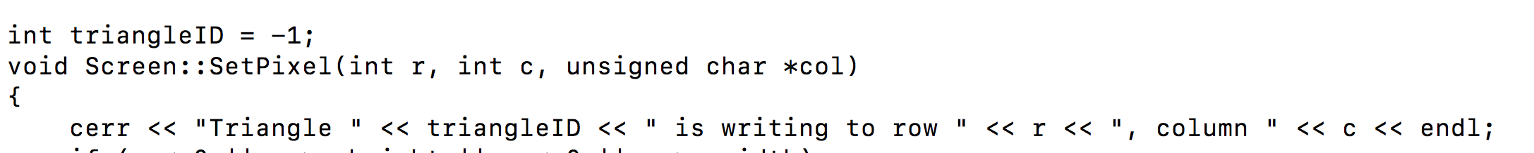
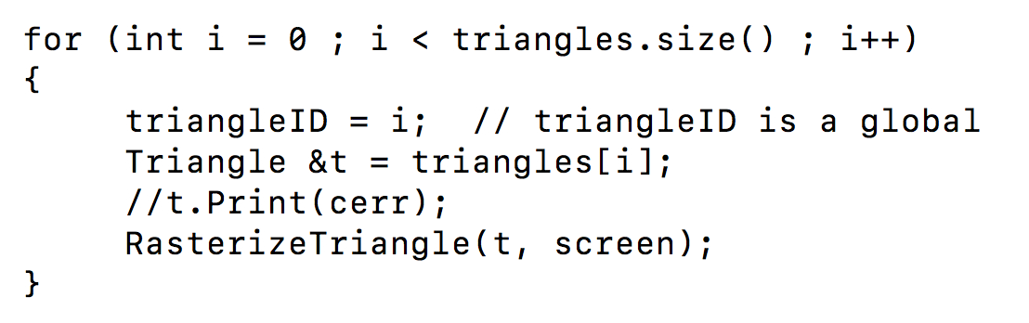
How did I get my output?

Slide 12
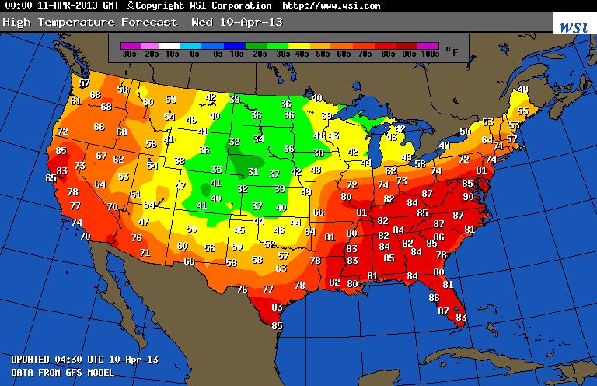
What is a field?
Example field (2D): temperature over the United States

Slide 13
How much data is needed to make this picture?
Example field (2D): temperature over the United States

Slide 14
Linear Interpolation for Scalar Field F
F(A)
F(X)
F(B)
A
X
B

Slide 15
Linear Interpolation (LERP) for Scalar Field F
General equation to interpolate:
F(X) = F(A) + t*(F(B)-F(A))
t is proportion of X between A and B
t = (X-A)/(B-A)
F(A)
F(X)
F(B)
A
X
B

Slide 16
Quiz Time #4
F(3) = 5, F(6) = 11
What is F(4)?
= 5 + (4-3)/(6-3)*(11-5) = 7
General equation to interpolate:
F(X) = F(A) + t*(F(B)-F(A))
t is proportion of X between A and B
t = (X-A)/(B-A)

Slide 17
Consider a single scalar field defined on a triangle.
Y-axis
Y=1
Y=0.5
X-axis
Y=0
X=0
X=0.5
X=1
X=1.5
X=2

Slide 18
Consider a single scalar field defined on a triangle.
Y-axis
V2
Y=1
F(V2) = 2
Y=0.5
V1
V3
F(V1) = 10
F(V3) = -2
X-axis
Y=0
X=0
X=0.5
X=1
X=1.5
X=2

Slide 19
What is F(V4)?
Y-axis
V2
Y=1
F(V2) = 2
Y=0.5
V4, at (0.5, 0.25)
V1
V3
F(V1) = 10
F(V3) = -2
X-axis
Y=0
X=0
X=0.5
X=1
X=1.5
X=2

Slide 20
What is F(V4)?
Y-axis
V2
Y=1
F(V2) = 2
Y=0.5
V5
V4, at (0.5, 0.25)
V6
V1
V3
F(V1) = 10
F(V3) = -2
X-axis
Y=0
X=0
X=0.5
X=1
X=1.5
X=2

Slide 21
Steps to follow:
Calculate V5, the left intercept for Y=0.25
Calculate V6, the right intercept for Y=0.25
Calculate V4, which is between V5 and V6

Slide 22
(Here’s the slides I screwed up on last week)

Slide 23
What is the X-location of V5?
Y-axis
V2
Y=1
F(V2) = 2
F(v1) = A → F(0) = 0
F(v2) = B → F(1) = 1
F(v) = A + ((v-v1)/(v2-v1))*(B-A):
F(v) = 0.25, find v
0.25 = 0 + ((v-0)/(1-0)*(1-0)
v = 0.25
Y=0.5
V5
V4, at (0.5, 0.25)
V6
V1
V3
F(V1) = 10
F(V3) = -2
X-axis
Y=0
X=0
X=0.5
X=1
X=1.5
X=2

Slide 24
What is the F-value of V5?
Y-axis
V2
Y=1
F(V2) = 2
F(v1) = A → F(0) = 10
F(v2) = B → F(1) = 2
F(v) = A + ((v-v1)/(v2-v1))*(B-A):
v = 0.25, find F(v)
F(v) = 10 + ((0.25-0)/(1-0))*(2-10)
= 10 + 0.25*-8 = 10 -2 = 8
Y=0.5
V5
V4, at (0.5, 0.25)
V6
V1
V3
F(V1) = 10
F(V3) = -2
X-axis
Y=0
X=0
X=0.5
X=1
X=1.5
X=2

Slide 25
Why did I screw up?
The logic in the slide?
→ interpolate to X
→ once you know X, use that to find V
Why did this screw me up?
→ you can interpolate to V directly
The previous slide is particularly confusing because it is along the line Y=X.

Slide 26
(1, 5), Field value = 3
If y-value == 1, then two questions:
What is X value?
What is field value?
x
(0, 0), Field value = 6

Slide 27
(1, 5), Field value = 3
If y-value == 1, then two questions:
What is X value?
What is field value?
x
(0, 0), Field value = 6

Slide 28
(1, 5), Field value = 3
If y-value == 1, then two questions:
What is X value?
→
Option 1: solve for line (what we did before)
(could actually use LERP formula too)
x
(0, 0), Field value = 6

Slide 29
(1, 5), Field value = 3
Pb
If y-value == 1, then two questions:
What is field value?
→
Use LERP formula
F(1) = F(0) + t*(F(5)-F(1))
= 6 + 0.2 *(3-6) = 5.4
t = (1-0) / (5-0)
= (Pn_y – Pa_y) / (Pb_y – Pa_y)
x
Pn
(0, 0), Field value = 6
Pa

Slide 30
What is the X-location of V6?
Y-axis
V2
Y=1
F(V2) = 2
F(v1) = A → F(1) = 1
F(v2) = B → F(2) = 0
F(v) = A + ((v-v1)/(v2-v1))*(B-A):
F(v) = 0.25, find v
0.25 = 1 + ((v-1)/(2-1)*(0-1)
= 1 + (v-1)*(-1)
0.25 = 2 - v
v = 1.75
Y=0.5
V5
V4, at (0.5, 0.25)
V6
V1
V3
F(V1) = 10
F(V3) = -2
X-axis
Y=0
X=0
X=0.5
X=1
X=1.5
X=2

Slide 31
What is the F-value of V6?
This one is really bad:
Simpler version:
T = 0.25 → (0.25-0)/(1-0)
F(v) = -2 + 0.25(2 - -2) → -2+0.25*4 = -1
Y-axis
V2
Y=1
F(V2) = 2
F(v1) = A → F(1) = 2
F(v2) = B → F(2) = -2
F(v) = A + ((v-v1)/(v2-v1))*(B-A):
v = 1.75, find F(v)
F(v) = 2 + ((1.75-1)/(2-1)*(-2 - +2)
= 2 + (.75)*(-4)
= 2 - 3
= -1
Y=0.5
V5
V4, at (0.5, 0.25)
V6
V1
V3
F(V1) = 10
F(V3) = -2
X-axis
Y=0
X=0
X=0.5
X=1
X=1.5
X=2

Slide 32
What is the F-value of V5?
Y-axis
V2
Y=1
Y=0.5
L(V5) = (0.25, 0.25)
F(V5) = 8
L(V6) = (1.75, 0.25)
F(V6) = -1
V5
V4, at (0.5, 0.25)
V6
V1
V3
F(V1) = 10
F(V3) = -2
X-axis
Y=0
X=0
X=0.5
X=1
X=1.5
X=2

Slide 33
What is the F-value of V5?
F(v1) = A → F(0.25) = 8
F(v2) = B → F(1.75) = -1
F(v) = A + ((v-v1)/(v2-v1))*(B-A):
v = 0.5, find F(v)
F(v) = 8 + ((0.5-0.25)/(1.75-0.25))*(-1-8)
= 8 + (0.25/1.5)*9 = 8-1.5 = 6.5
Y-axis
V2
Y=1
Y=0.5
L(V5) = (0.25, 0.25)
F(V5) = 8
L(V6) = (1.75, 0.25)
F(V6) = -1
V5
V4, at (0.5, 0.25)
V6
V1
V3
F(V1) = 10
F(V3) = -2
X-axis
Y=0
X=0
X=0.5
X=1
X=1.5
X=2

Slide 34

Visualization of F
F=10
F=-2
Not defined
How do you think this picture was made?

Slide 35
Now We Understand Interpolation Let’s Use It For Two New Ideas: Color Interpolation & Z-buffer Interpolation

Slide 36
Colors

Slide 37
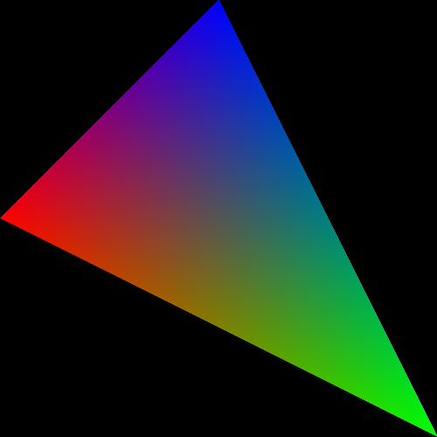
What about triangles that have more than one color?

Slide 38



The color is in three channels, hence three scalar fields defined on the triangle.
Red channel
Green channel
Blue channel

Slide 39
Scanline algorithm
Determine rows of pixels triangles can possibly intersect
Call them rowMin to rowMax
rowMin: ceiling of smallest Y value
rowMax: floor of biggest Y value
For r in [rowMin → rowMax] ; do
Find end points of r intersected with triangle
Call them leftEnd and rightEnd
For c in [ceiling(leftEnd) → floor(rightEnd) ] ; do
ImageColor(r, c) ← triangle color

Slide 40
Scanline algorithm w/ Color
Determine rows of pixels triangles can possibly intersect
Call them rowMin to rowMax
rowMin: ceiling of smallest Y value
rowMax: floor of biggest Y value
For r in [rowMin → rowMax] ; do
Find end points of r intersected with triangle
Call them leftEnd and rightEnd
Calculate Color(leftEnd) and Color(rightEnd) using interpolation from triangle vertices
For c in [ceiling(leftEnd) → floor(rightEnd) ] ; do
Calculate Color(r, c) using Color(leftEnd) and Color(rightEnd)
ImageColor(r, c) ← Color(r, c)

Slide 41
Simple Example
V(2,2)
RGB = (0,1,0)
V(1,1)
V(2,1)
V(3,1)
RGB = (0.5,0.5,0)
RGB = (0.25,0.5,0.25)
RGB = (0,0.5,0.5)
V(0,0)
V(4,0)
RGB = (1,0,0)
What is the color at (2, 1)?
RGB = (0,0,1)

Slide 42
Scanline algorithm w/ Color
Determine rows of pixels triangles can possibly intersect
Call them rowMin to rowMax
rowMin: ceiling of smallest Y value
rowMax: floor of biggest Y value
For r in [rowMin → rowMax] ; do
Find end points of r intersected with triangle
Call them leftEnd and rightEnd
Calculate Color(leftEnd) and Color(rightEnd) using interpolation from triangle vertices
For c in [ceiling(leftEnd) → floor(rightEnd) ] ; do
Calculate Color(r, c) using Color(leftEnd) and Color(rightEnd)
ImageColor(r, c) ← Color(r, c)
Calculating multiple color channels here!

Slide 43
Important
ceiling / floor: needed to decide which pixels to deposit colors to
used: rowMin / rowMax, leftEnd / rightEnd
not used: when doing interpolation
Color(leftEnd) and Color(rightEnd) should be at the intersection locations … no ceiling/floor.

Slide 44
How To Resolve When Triangles Overlap: The Z-Buffer

Slide 45
Imagine you have a cube where each face has its own color….
Face | Color
Front | Blue
Right | Green
Top | Red
Back | Yellow
Left | Purple
Bottom | Cyan
View from “front/top/right” side

Slide 46
Imagine you have a cube where each face has its own color….
How do we render the pixels that we want and ignore the pixels from faces that are obscured?
View from “front/top/right” side
View from “back/bottom/left” side

Slide 47
Consider a scene from the right side
Face | Color
Front | Blue
Right | Green
Top | Red
Back | Yellow
Left | Purple
Bottom | Cyan
Camera/eyeball
Camera oriented directly at Front face,
seen from the Right side

Slide 48
Consider the scene from the top side
Face | Color
Front | Blue
Right | Green
Top | Red
Back | Yellow
Left | Purple
Bottom | Cyan
Camera/eyeball
Camera oriented directly at Front face,
seen from the Top side

Slide 49
What do we render?
Green, Red, Purple, and Cyan all “flat” to camera. Only need to render Blue and Yellow faces (*).
Face | Color
Front | Blue
Right | Green
Top | Red
Back | Yellow
Left | Purple
Bottom | Cyan
Camera/eyeball
Camera oriented directly at Front face,
seen from the Top side

Slide 50
What do we render?
What should the picture look like?
What’s visible? What’s obscured?
Face | Color
Front | Blue
Right | Green
Top | Red
Back | Yellow
Left | Purple
Bottom | Cyan
Camera/eyeball
Camera oriented directly at Front face,
seen from the Top side

Slide 51
New field associated with each triangle: depth
Project 1B,1C:
class Triangle
{
public:
Double X[3];
Double Y[3];
…
};
Now…
Double Z[3];

Slide 52
What do we render?
Z=0
Z=-1
Face | Color
Front | Blue
Right | Green
Top | Red
Back | Yellow
Left | Purple
Bottom | Cyan
Camera/eyeball
Camera oriented directly at Front face,
seen from the Top side

Slide 53
Using depth when rendering
Use Z values to guide which geometry is displayed and which is obscured.
Example….

Slide 54
Consider 4 triangles with constant Z values
Z=-0.35
Z=-0.5
Z=-0.65
Z=-0.8

Slide 55
Consider 4 triangles with constant Z values
How do we make this picture?
Z=-0.35
Z=-0.5
Z=-0.65
Z=-0.8

Slide 56
Idea #1
Sort triangles “back to front” (based on Z)
Render triangles in back to front order
Overwrite existing pixels

Slide 57
Idea #2
Sort triangles “front to back” (based on Z)
Render triangles in front to back order
Do not overwrite existing pixels.

Slide 58
But there is a problem…
(0, 1, -0.4)
(0, 1.5, -0.4)
(-1, -1, -0.3)
(1, -1, -0.5)
(-2, -1.5, -0.5)
(2, -1.5, -0.3)

Slide 59
The Z-Buffer Algorithm
The preceding 10 slides were designed to get you comfortable with the notion of depth/Z.
The Z-Buffer algorithm is the way to deal with overlapping triangles when doing rasterization.
It is the technique that GPUs use.
It works with opaque triangles, but not transparent geometry, which requires special handling
Transparent geometry discussed week 7.
Uses the front-to-back or back-to-front sortings just discussed.

Slide 60
The Z-Buffer Algorithm: Data Structure
Existing: for every pixel, we store 3 bytes:
Red channel, green channel, blue channel
New: for every pixel, we store a floating point value:
Depth buffer (also called “Z value”)
Now 7 bytes per pixel (*)
(*): 8 with RGBA

Slide 61
The Z-Buffer Algorithm: Initialization
Existing:
For each pixel, set R/G/B to 0.
New:
For each pixel, set depth value to -1.
Valid depth values go from -1 (back) to 0 (front)
This is partly convention and partly because it “makes the math easy” when doing transformations.

Slide 62
Scanline algorithm
Determine rows of pixels triangles can possibly intersect
Call them rowMin to rowMax
rowMin: ceiling of smallest Y value
rowMax: floor of biggest Y value
For r in [rowMin → rowMax] ; do
Find end points of r intersected with triangle
Call them leftEnd and rightEnd
For c in [ceiling(leftEnd) → floor(rightEnd) ] ; do
ImageColor(r, c) ← triangle color

Slide 63
Scanline algorithm w/ Z-Buffer
Determine rows of pixels triangles can possibly intersect
Call them rowMin to rowMax
rowMin: ceiling of smallest Y value
rowMax: floor of biggest Y value
For r in [rowMin → rowMax] ; do
Find end points of r intersected with triangle
Call them leftEnd and rightEnd
Interpolate z(leftEnd) and z(rightEnd) from triangle vertices
For c in [ceiling(leftEnd) → floor(rightEnd) ] ; do
Interpolate z(r,c) from z(leftEnd) and z(rightEnd)
If (z(r,c) > depthBuffer(r,c))
ImageColor(r, c) ← triangle color
depthBuffer(r,c) = z(r,c)

Slide 64
The Z-Buffer Algorithm: Example
(0,12)
(12,12)
(2.5,10.5, -0.25)
Y=5
(2.5,2.5, -0.5)
(10.5,2.5, -1)
(0,0)
(12,0)

Slide 65
The Z-Buffer Algorithm: Example
(0,12)
(12,12)
(6.3, 8.5, -0.75)
Y=5
(1.3,3.5, -1)
(11.3, 3.5, -0.5)
(0,0)
(12,0)

Slide 66
Interpolation and Triangles
We introduced the notion of interpolating a field on a triangle
We used the interpolation in two settings:
1) to interpolate colors
2) to interpolate depths for z-buffer algorithm
Project 1D: you will be adding color interpolation and the z-buffer algorithm to your programs.

Slide 67

Project #1D (5%), Due Thurs Jan 31st
Goal: interpolation of color and zbuffer
Extend your project1C code
File proj1d_geometry.vtk available on web (1.4MB)
File “reader1d.cxx” has code to read triangles from file.
No Cmake, project1d.cxx

Slide 68
Color is now floating-point
We will be interpolating colors, so please use floating point (0 → 1)
Keep colors in floating point until you assign them to a pixel
Fractional colors? → use ceil_441…
ceil_441(value*255)

Slide 69
Changes to data structures
class Triangle
{
public:
double X[3], Y[3], Z[3];
double colors[3][3];
};
→ reader1d.cxx will not compile until you make these changes

